Slide 1
GESTURE RECOGNTION IN MUSIC
MASTERS PROJECT/ INDEPENDENT STUDY (ART 890) SANDEEP DASARI
Github: https://sandcobainer.github.io/touchfreemusic/

Slide 2
overview
Rise of Music Technology
MIDI and Audio Synthesis
Max MSP
Machine Learning and Gesture Recognition in music
Real time application with Leap Motion
Building Synthesizers and plugins for Ableton Live
Future Work and Ideas

Slide 3
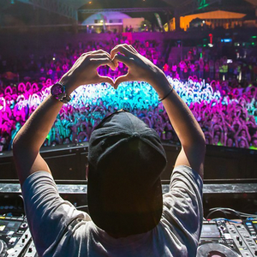
Music technology
Electronic Dance Music (EDM) is the most popular form of music around the world today.
Hundreds of sub-genres and languages
Not just dance music.
House parties, pirate radios, coffee shop shows
Concept of individual music production
Sampling and remixes

Slide 4
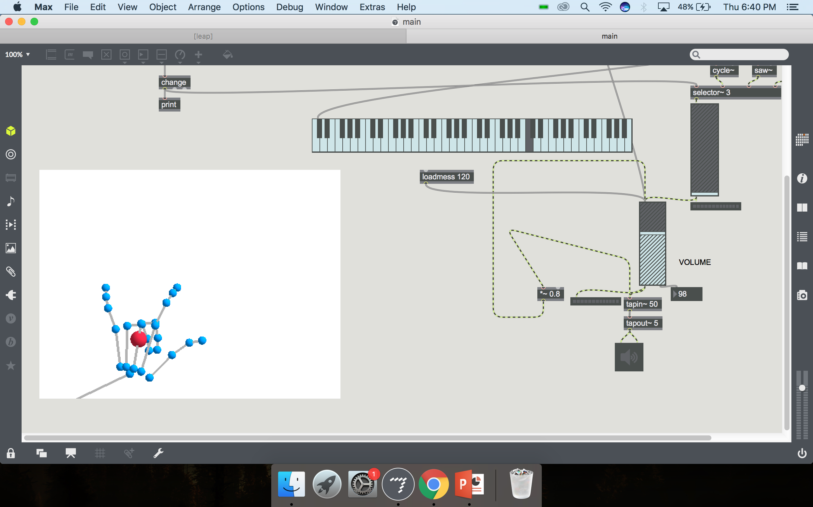
History of midi and synthesizers(1981)
Musical Instrument Digital Interface is a protocol to connect electronic music instruments, computers and audio devices.
Founded by Dave Smith (Sequential Circuits along with Roland)
Just digital event messages specifying pitch (frequency), velocity (amplitude)
Quickly adapted by engineers to build synthesizers, sampling machines, drum machines, turn tables
Audio Science embraced by musicians

Slide 5
Audio synthesis
Power of MIDI and Digital Signal Processing
Faster computers -> MORE DSP
Software for audio synthesis and sound generation
Miller Puckette’s work on Max (now Max MSP 8) started in 1985. I use Max/MSP 7.3.5 as my programming language
MAX/MSP is a modular programming langauge for music and multimedia maintained by Cycling’74
Similar programs in PureData, Supercollider, Sonic Pi were developed

Slide 6
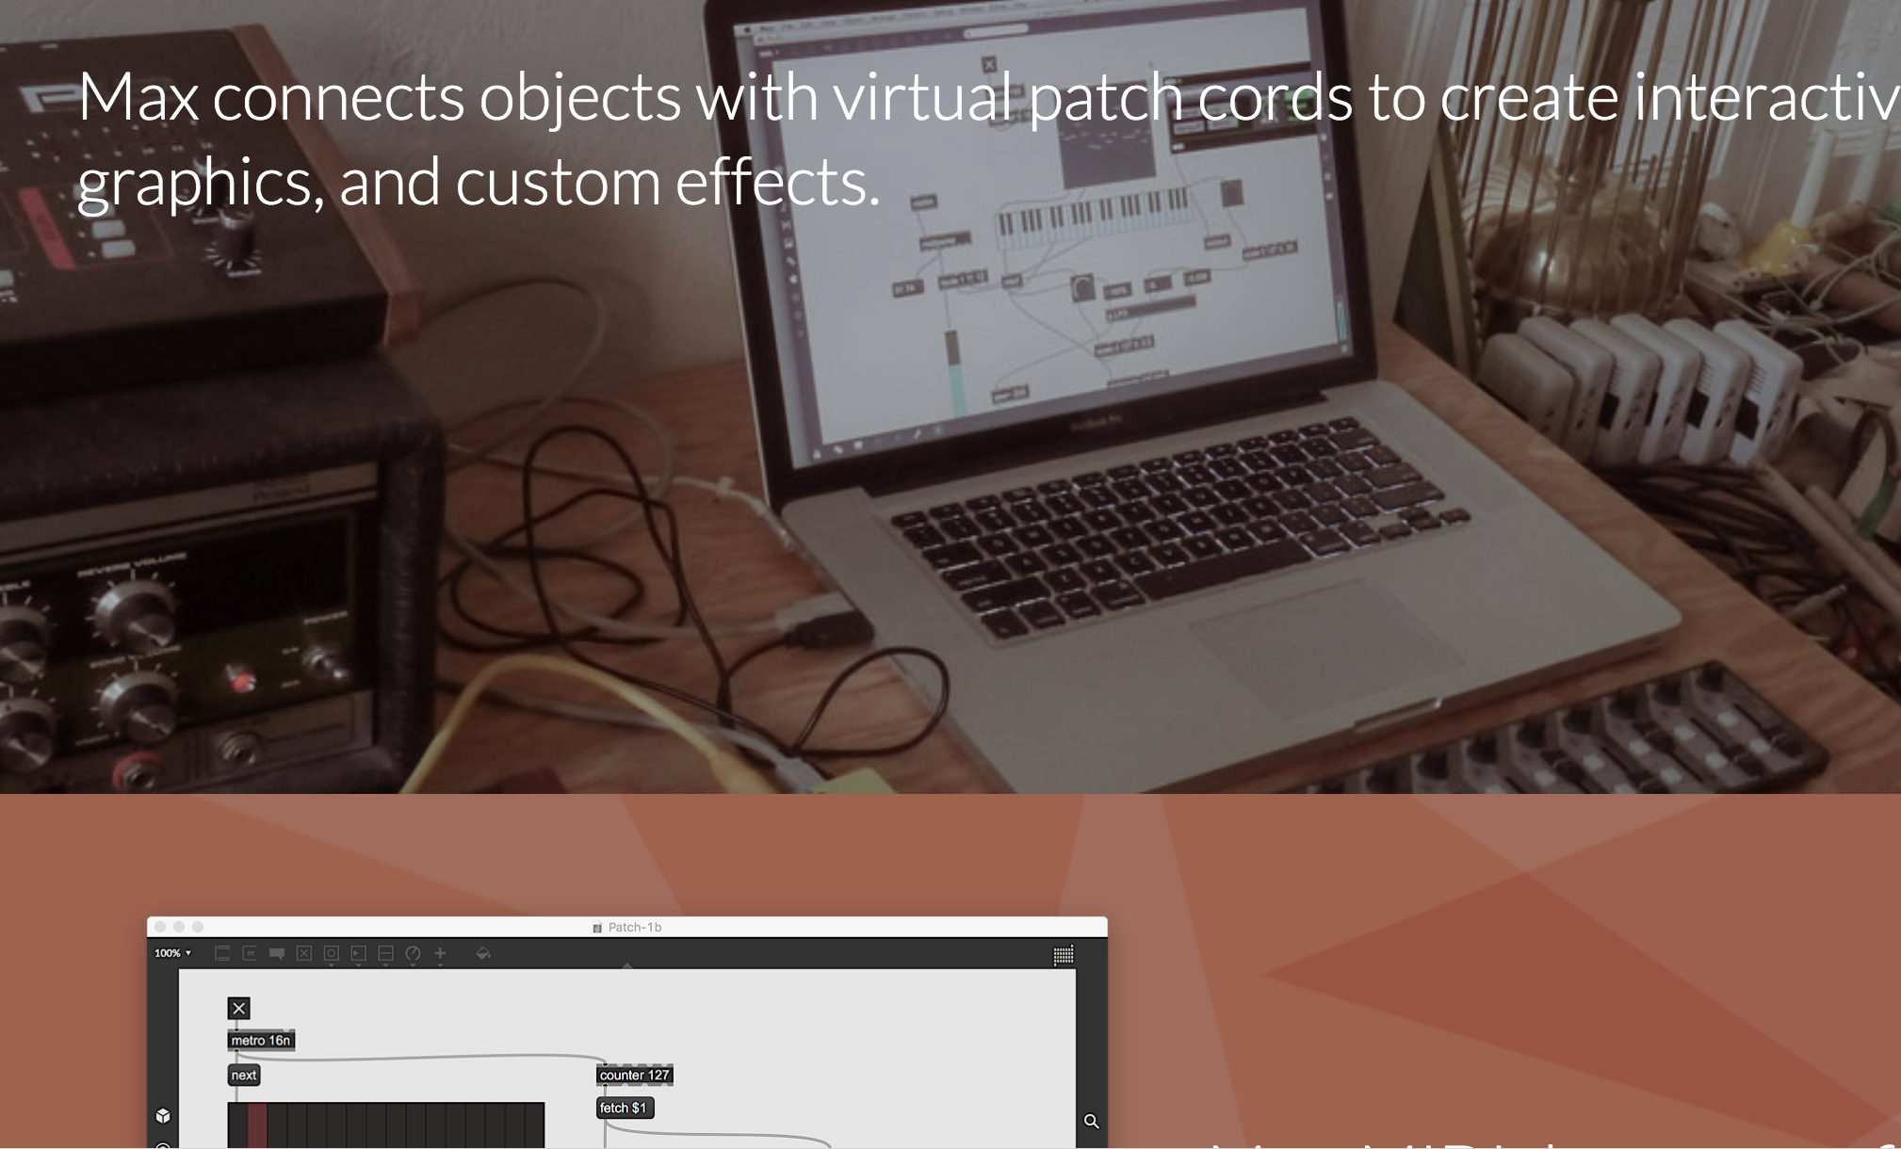
Max / MSp for real time MACHINE LEARNING
Flexible (own patches)
Modular
Easy data handling
Documentation / community
Fast and real time
Easy to prototype models
Support for Audio Synthesis
Simple predefined models

Slide 7
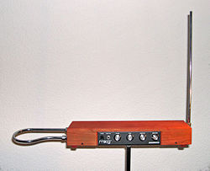
GESTURE RECOGNITION ON A THEREMIN
Theremin is an electronic musical instrument controller without physical contact.
Problem: Add gesture recognition to a theremin in real time
Classify hand gestures of the artist to perform changes in audio synthesis
Gestures fall into 2 kinds
1. static gestures
2. dynamic gestures

Slide 8
GESTURE RECOGNITION ON A THEREMIN
Classifying static gestures is easier (use classification models)
Chose SVM (complex dataset with many gestures but less amount of data)
Classifying dynamic gestures is tricky (Hidden Markov Models?)
define start and end of a gesture
speed of the gesture
Occlusion (overlapping hands)
noise (partial misclassification)

Slide 9
Data acquisition and features
Leap Motion is a computer hardware sensor that supports hand and finger motions as input without touching.
It gives detailed 3-D coordinates of fingers, bones, palm and elbow positions
Building features
distance between fingers to palm
distance between fingers
distance between pointing fingers and thumb
Feature set is a list of 12 euclidean distances

Slide 10
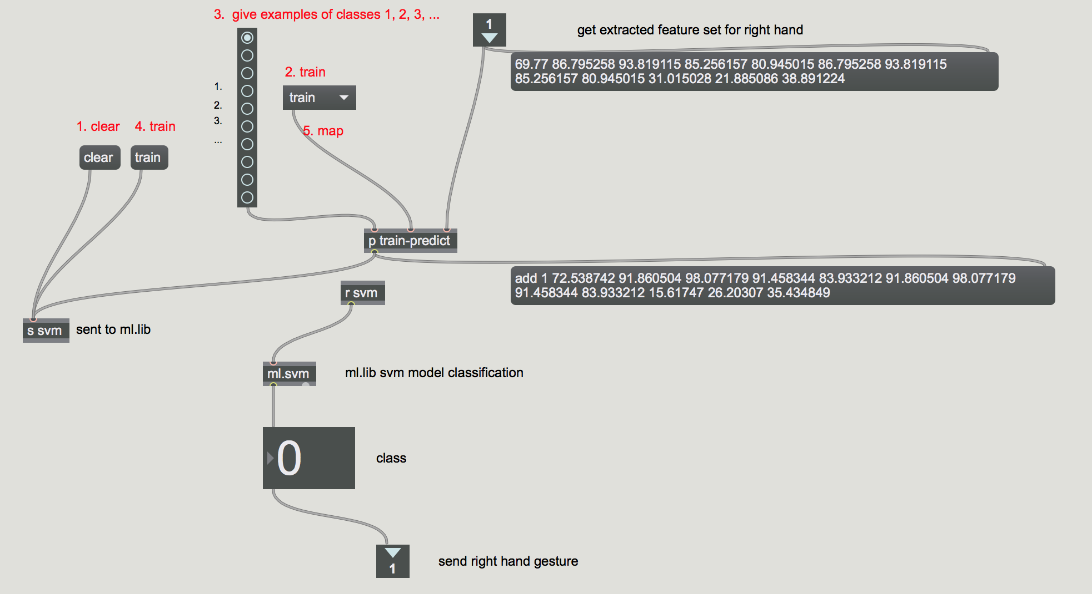
Writing train/map pipelines in max/msp
SVM
Train/Map pipeline
Finger feature set
10 classes

Slide 11
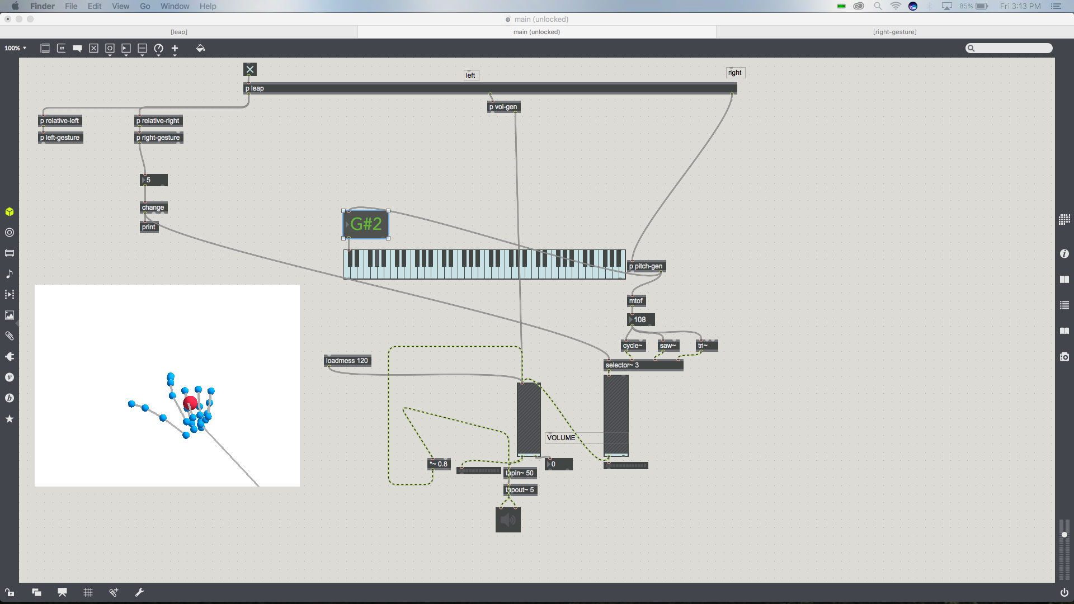
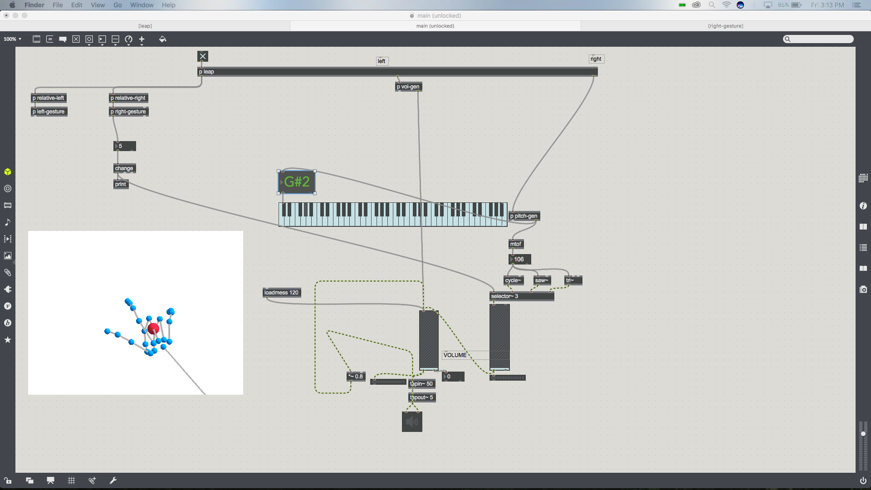
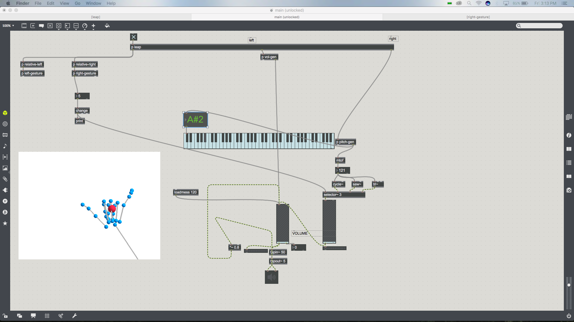
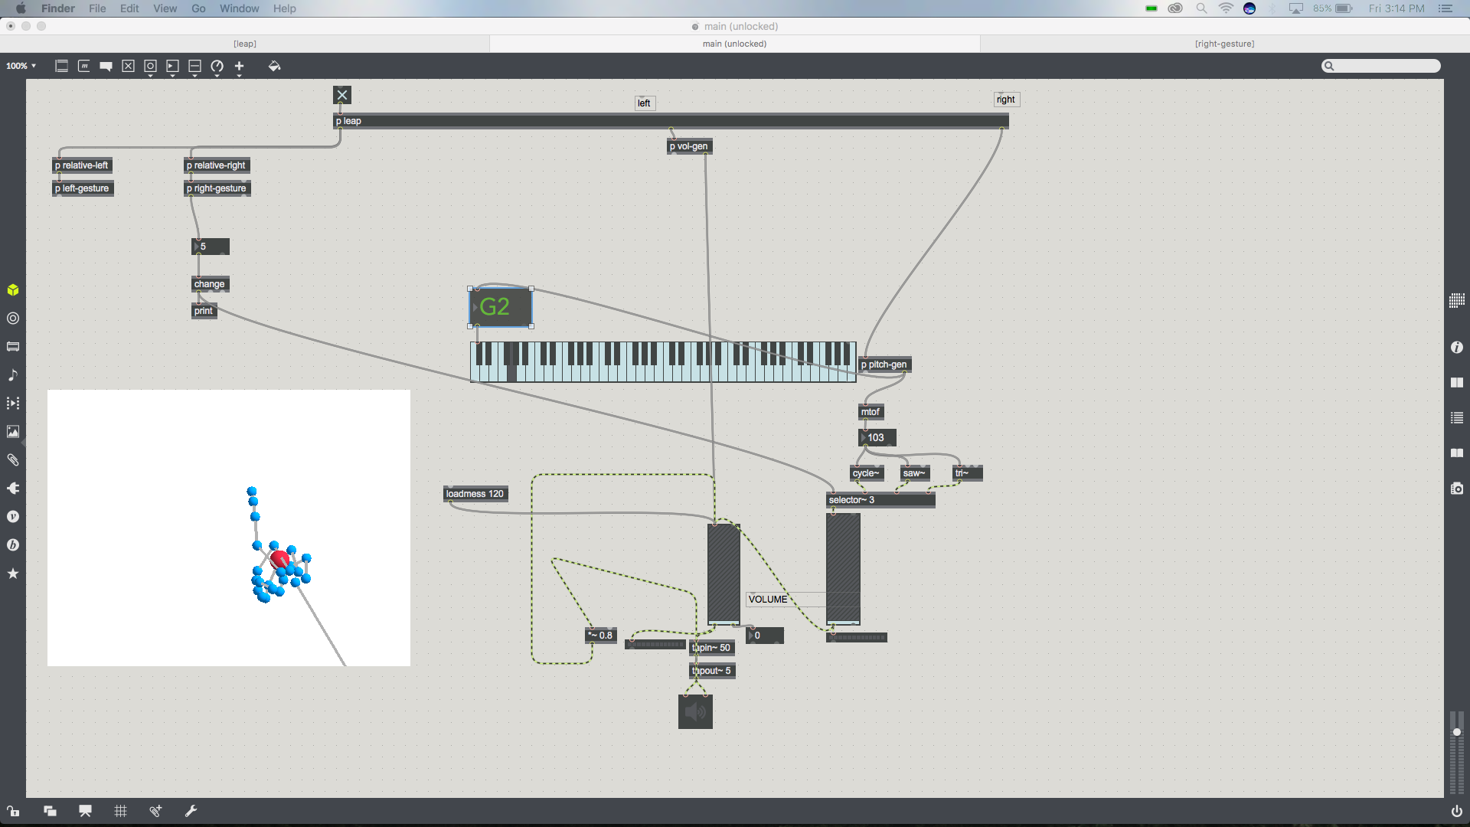
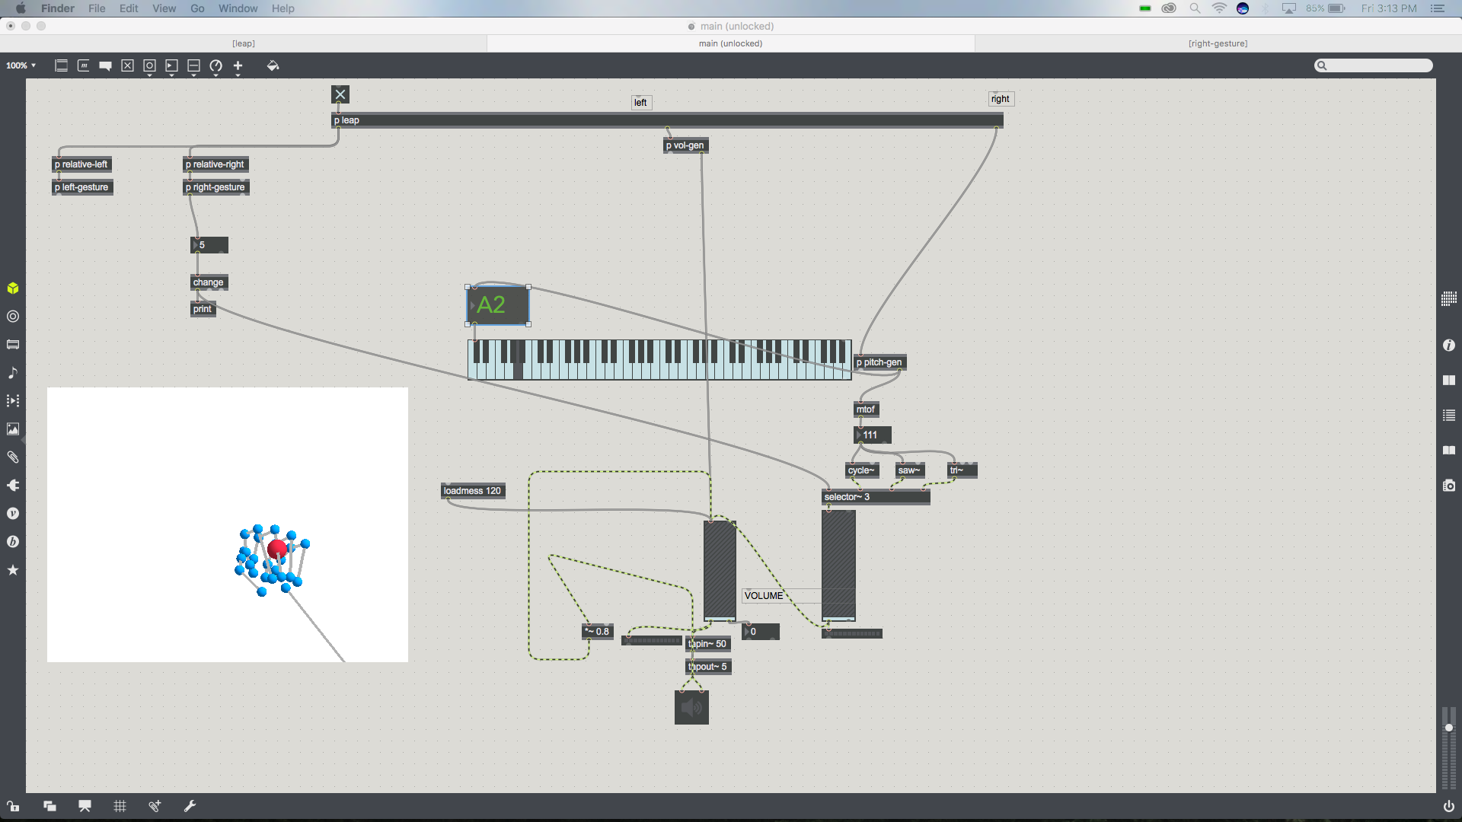

Classified gestures
Sine wave
Sawtooth
Triangular
Delay
Reverb
Distortion

Slide 12
Real time classification results
The classification gestures are sent to the audio synthesis plugins in real time to affect MIDI and DSP effects on the theremin.
Keeping everything inside MAX/MSP
Easy to build and release Max for Live plugins for Ableton Live
Playable virtual instrument without lag or sudden spikes in frequency or amplitude

Slide 13
FUTURE WORK
Improve timbre of sound by superimposing multiple oscillators(interference)
Develop real time gesture following to turn knobs and sliders
Use gesture following for detecting partial gestures – ACTIVE AREA OF RESEARCH
Combine usage of static and dynamic gestures for fluidic flow and efficient control

Slide 14
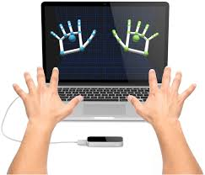
Demo/Feedback?

